Slide 1
校園
逸事

Slide 2
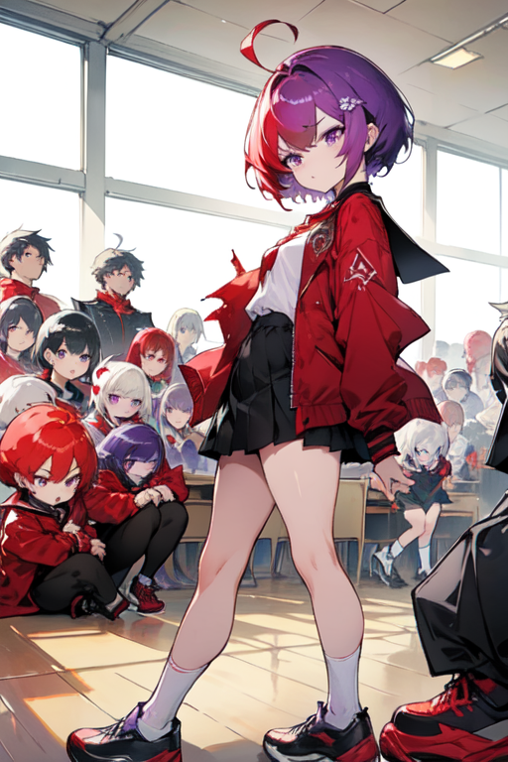

目 標

Slide 3
目 標
Notes:
ahoge, (crimson_hair), short_hair, eyebrows, ( (purple_eyes) ), wearing_a_blood-red_jacket, ( (short_white_socks) ), (black_footwear), female_school_student, classroom, (little_mons), (crowd), group_of_game_players, upscaling,

Slide 4
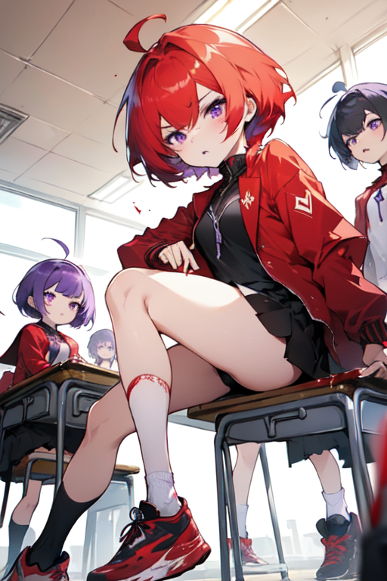
阻 礙

Slide 5
阻 礙
Notes:
ahoge, (crimson_hair), short_hair, eyebrows, ( (purple_eyes) ), wearing_a_blood-red_jacket, ( (short_white_socks) ), (black_footwear), female_school_student, classroom, (little_mons), (crowd), group_of_game_players, upscaling,

Slide 6
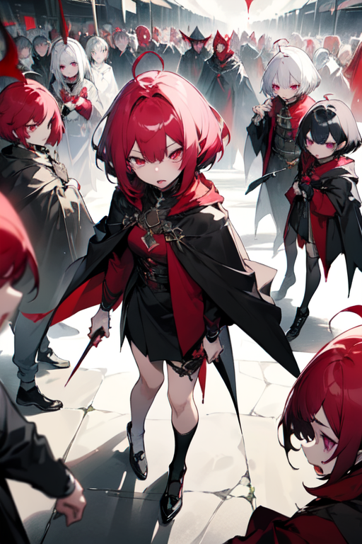
努 力
Notes:
ahoge, (burgundy_hair), short_hair, eyebrow härken, (（plum_eyes）), wearing a vampire cloak, (（short white socks）), (black_footwear), girl,(dark), (horror), scared expression, (littlemonster), (crowd), a group of gamers, quality boost,

Slide 7
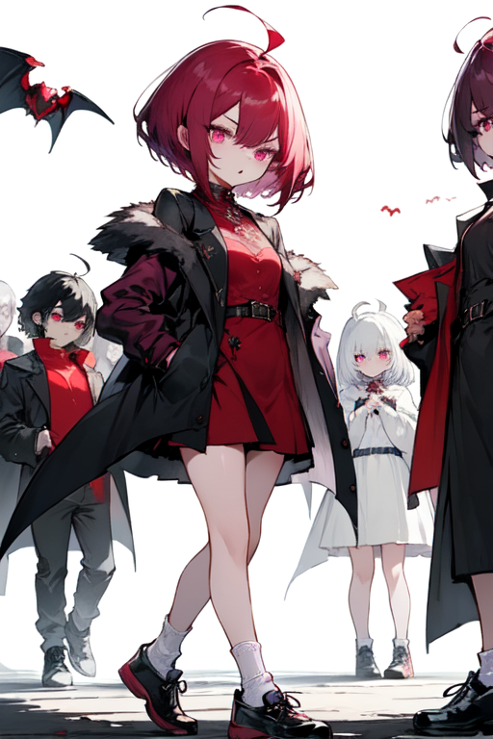
結 果
Notes:
ahoge, (burgundy_hair), short_hair, eyebrow_stubs, (((plum_eyes))), wearing_vampire_coat, ( (short_white_socks)), (black_footwear), girl, dark, horror, scared_look, (little_mons), (crowd), group_of_gamers, quality_up,

Slide 8
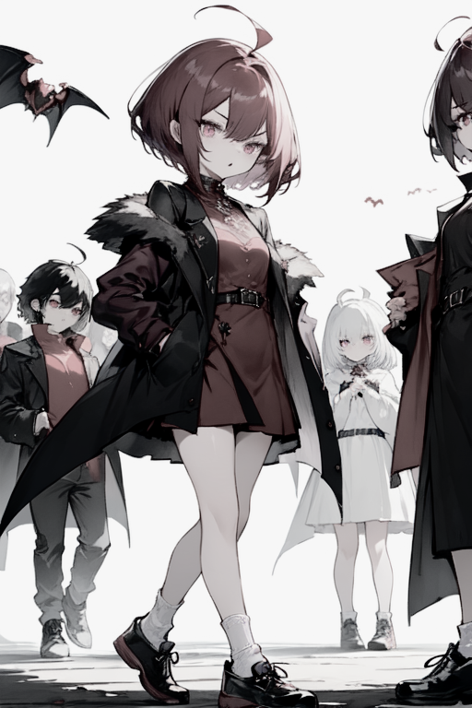
結 果

Slide 9
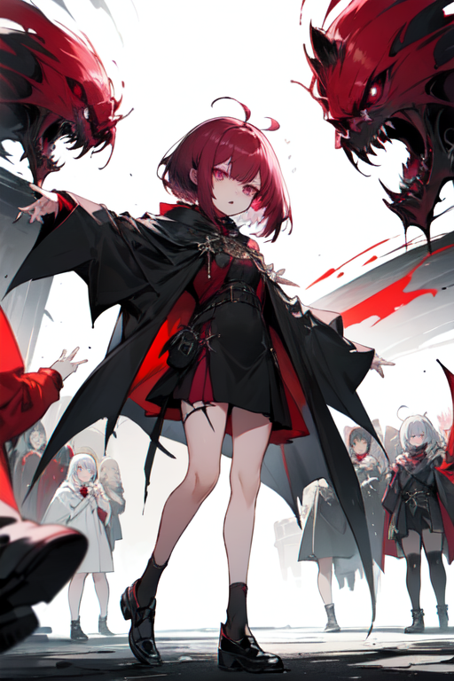
意 外
Notes:
ahoge, (burgundy_hair), short_hair, eyebrow härken, (（plum_eyes）), wearing a vampire cloak, (（short white socks）), (black_footwear), girl,(dark), (horror), scared expression, (littlemonster), (crowd), a group of gamers, quality boost,

Slide 10
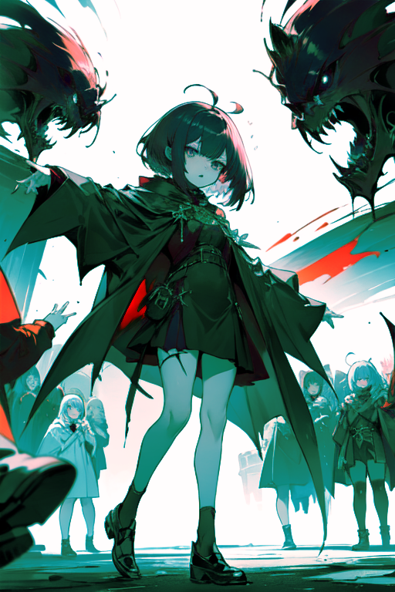
意 外

Slide 11
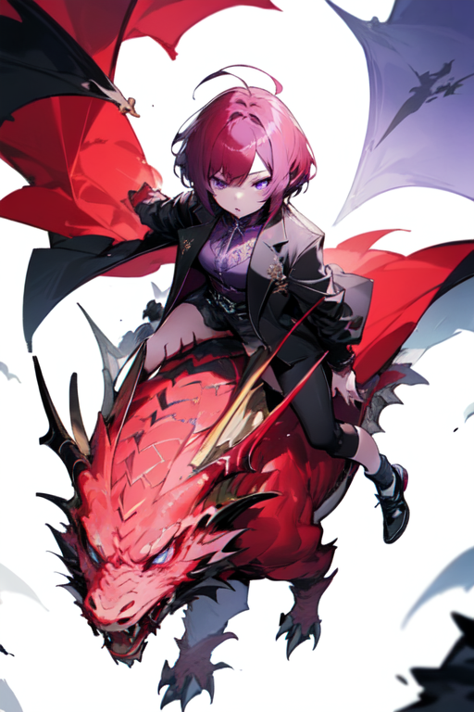
轉 折

Slide 12
轉 折
Notes:
ahoge, (burgundy_hair), short_hair, eyebrow_flags, (purple_hued_eyes), wearing_vampire_coat, (short_white_socks), (black_footwear), girl, (dark), (horror), dragon, riding_guardian_dragon, flying, (crowd), group_of_gamers, upscale,

Slide 13
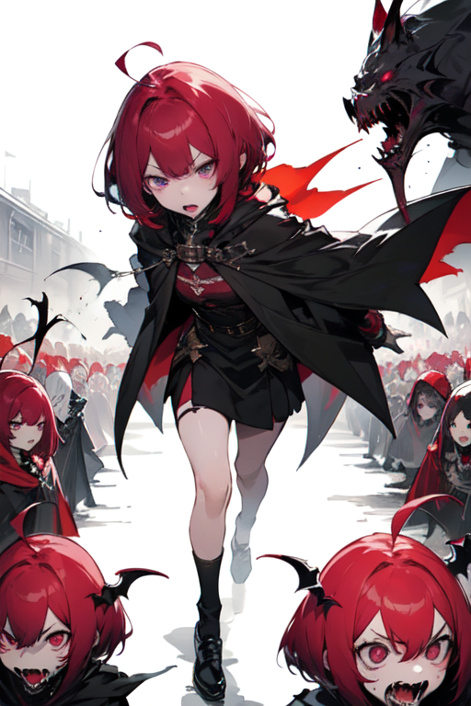
轉 折
Notes:
ahoge, (burgundy_hair), short_hair, eyebrow härken, (（plum_eyes）), wearing a vampire cloak, (（short white socks）), (black_footwear), girl,(dark), (horror), scared expression, (littlemonster), (crowd), a group of gamers, quality boost,

Slide 14

結 局

Slide 15
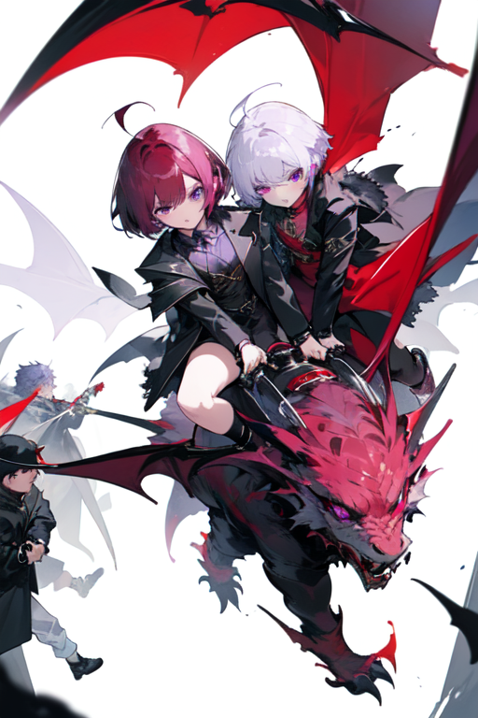
結 局
Notes:
ahoge, (burgundy_hair), short_hair, eyebrow_flags, (purple_hued_eyes), wearing_vampire_coat, (short_white_socks), (black_footwear), girl, (dark), (horror), dragon, riding_guardian_dragon, flying, (crowd), group_of_gamers, upscale,

